Slide 1
Drupal 8 Installing Composer for Acquia Dev Desktop (Mac)
Patrick Fobes & Michael H Chase

Slide 2
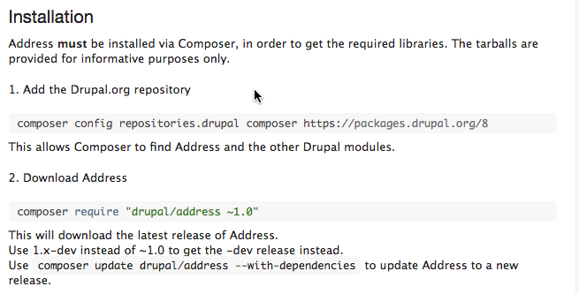
Why are we installing composer?
Some Drupal Modules must be installed using composer
Example: Drupal 8 Address module: https://www.drupal.org/project/address

Slide 3
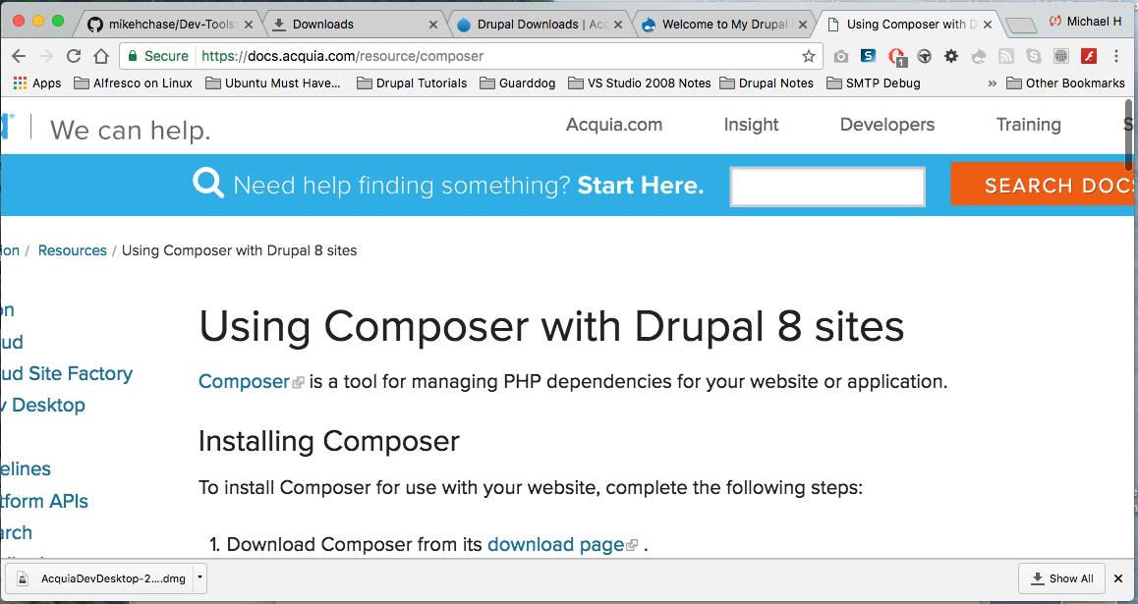
We used the information we found in this web article to install composer: https://docs.acquia.com/resource/composer

Slide 4
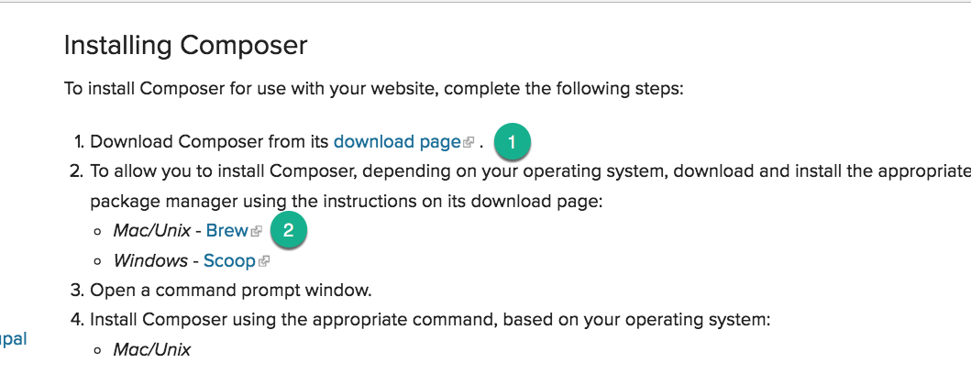
(1) Go to the Composer download page

Slide 5
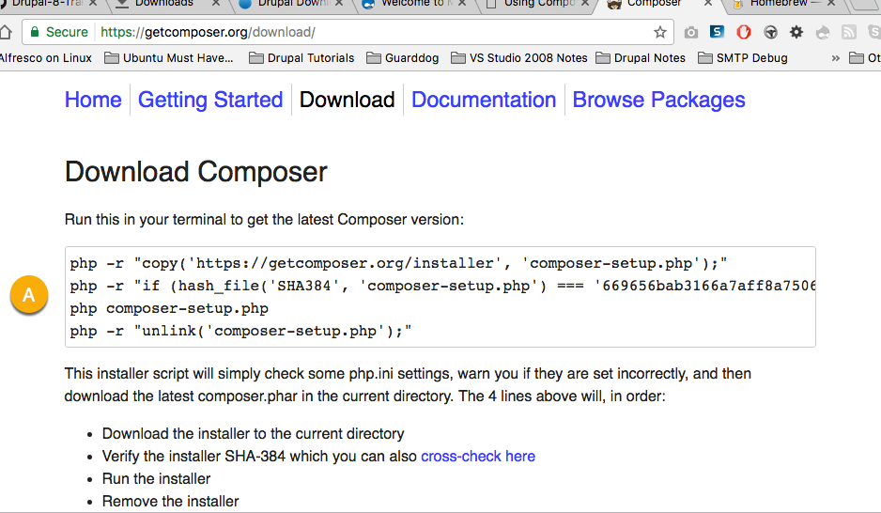
(A) Run this PHP command in the Acquia Terminal window

Slide 6
Steps to Install Composer on Acquia Dev Desktop
On Acquia dev desktop, select Drush Console icon (see next page)
On a web browser, access the article and follow it’s instructions
https://docs.acquia.com/resource/composer
Copy and run the download composer PHP command in Terminal
Access the Brew page https://brew.sh
Copy the run Brew command, paste and execute it in Drush console
Run a second set of commands to update Brew and install composer via Brew
Run two composer commands to install the Address module and all required libraries

Slide 7
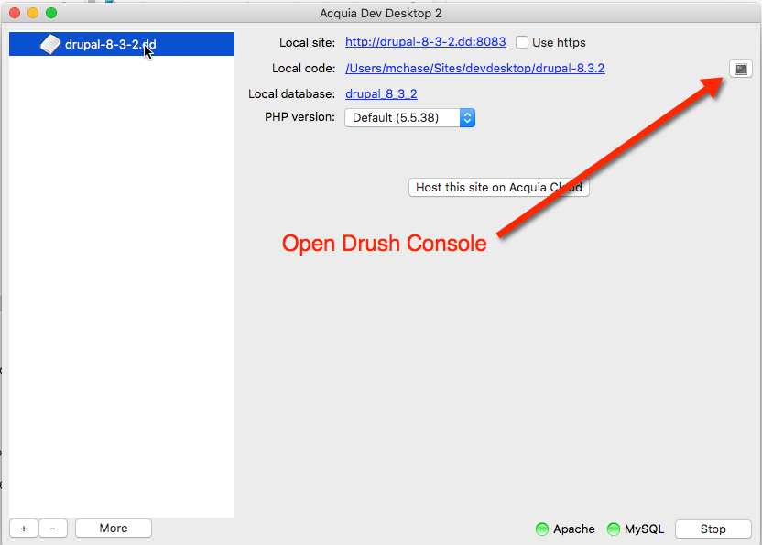
First: Select Open Drush Console icon

Slide 8
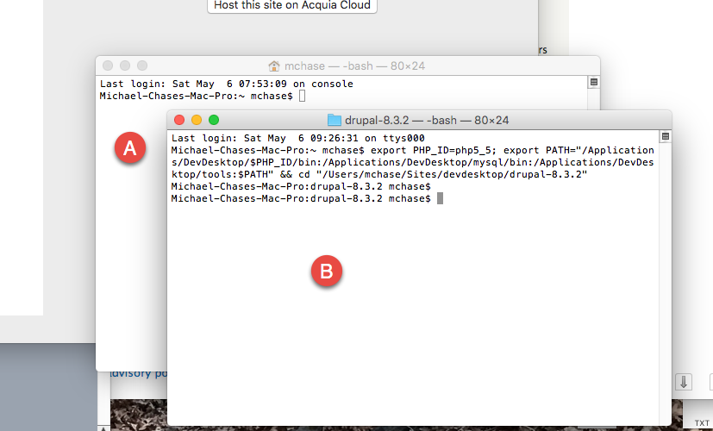
Selecting the Drush Console opens up 2 Bash Terminal Windows on my Mac. Use the one that has the Drupal 8 path in the command prompt (See B below)

Slide 9
PHP Composer Download command Don’t copy and paste the command from here. Copy it from the Web page at https://getcomposer.org/download/
php -r "copy('https://getcomposer.org/installer', 'composer-setup.php');" php -r "if (hash_file('SHA384', 'composer-setup.php') === '669656bab3166a7aff8a7506b8cb2d1c292f042046c5a994c43155c0be6190fa0355160742ab2e1c88d40d5be660b410') { echo 'Installer verified'; } else { echo 'Installer corrupt'; unlink('composer-setup.php'); } echo PHP_EOL;" php composer-setup.php php -r "unlink('composer-setup.php');"

Slide 10
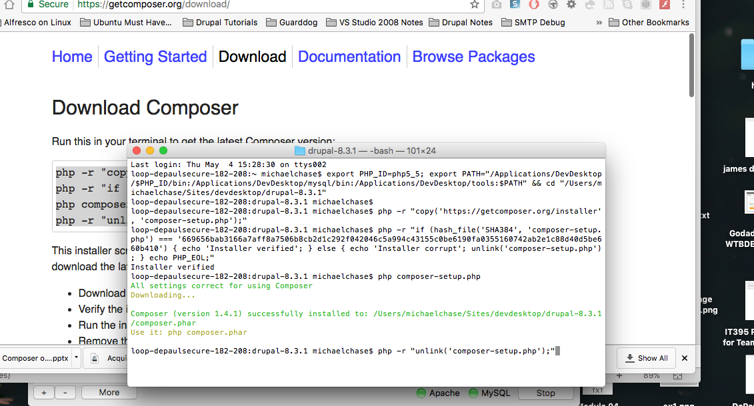
(A) Running the Composer download PHP command

Slide 11
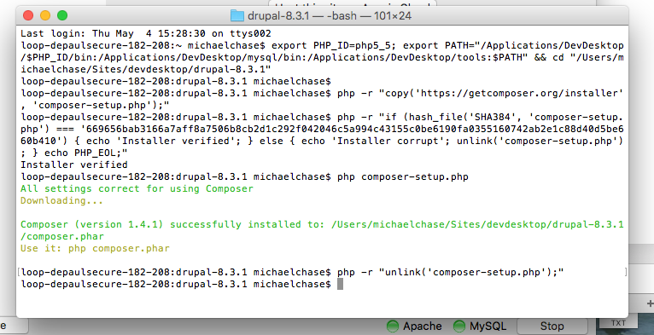
There are actually two commands

Slide 12
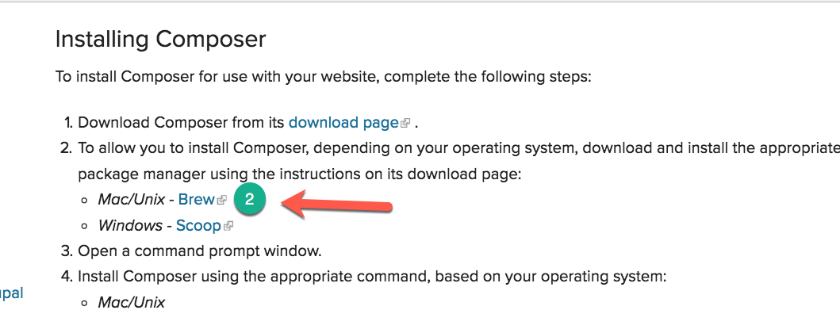
I’m on a Mac, so I access the Mac/Unix Brew information

Slide 13
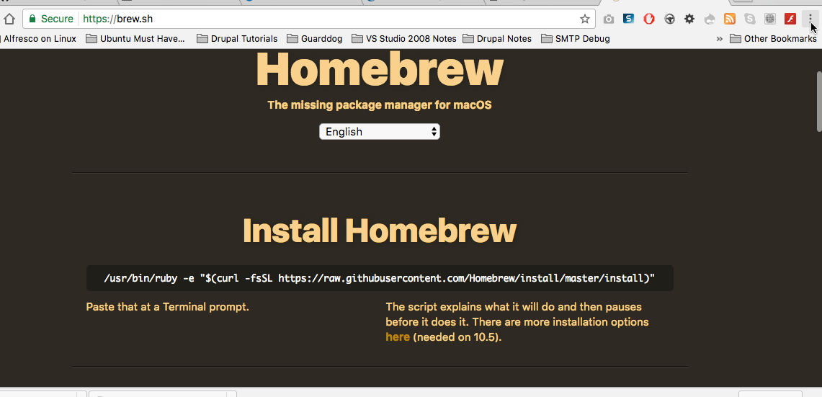
Copy and Run the Brew install on the Terminal https://brew.sh

Slide 14
The Brew Command Do not copy the command from here, copy it from the Brew/Unix web page
/usr/bin/ruby -e "$(curl -fsSL https://raw.githubusercontent.com/Homebrew/install/master/install)"

Slide 15
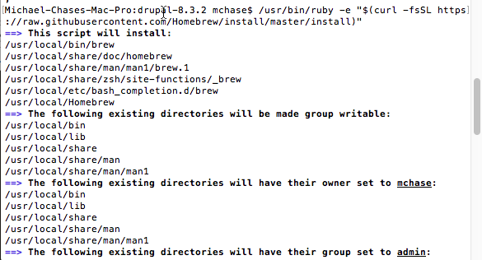
Running the Brew install command

Slide 16
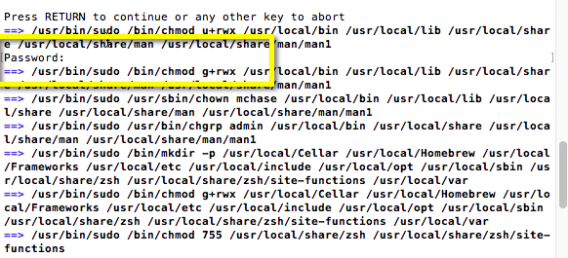
Running the ruby command, first it requires you to hit ENTER to continue, then asks for the Mac Admin password

Slide 17
BREW INSTALL PROBLEM
When I tried to continue with the process by entering the “brew update” command, it would not run
I reproduced this problem on a different Mac
My solution is to run the ruby BREW install command a second time.
The command appears to behave differently with a better outcome
After running the command again, I am able to continue with the next set of brew commands

Slide 18
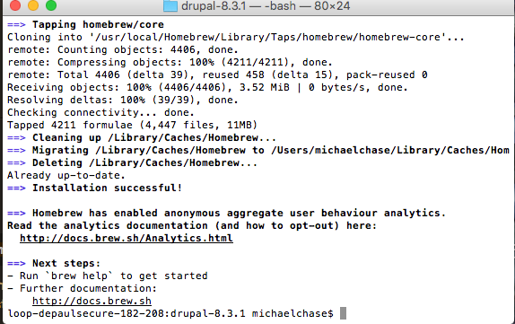
2nd Run of the Ruby command completed

Slide 19
2nd set of Brew commands: https://gist.github.com/tomysmile/3b37ab4a1ddd604093fe724d0a882166
Run a set of commands to update Brew and install Composer via Brew
brew update
brew tap homebrew/dupe
brew tap homebrew/php
brew install php56
brew install composer
To test composer installation run the command below (that’s a capital V):
composer –V

Slide 20
Run the next set of Brew commands to update Brew and install composer
brew update
brew tap homebrew/dupes
brew tap homebrew/php
brew install php56
brew install composer

Slide 21
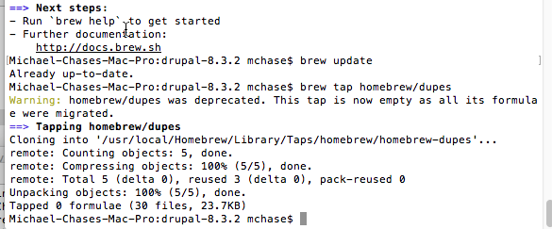
brew update brew tap homebrew/dupes

Slide 22
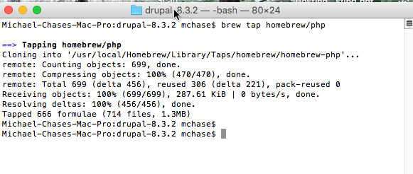
brew tap homebrew/php

Slide 23
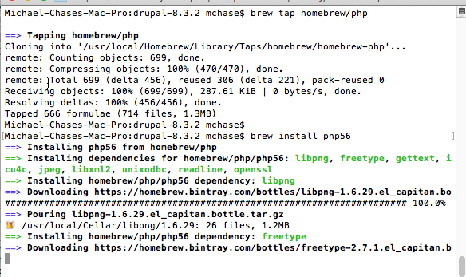
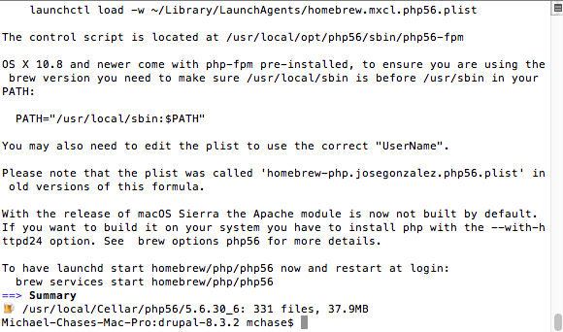
brew install php56

Slide 24
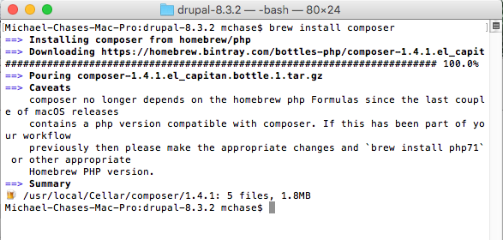
brew install composer

Slide 25
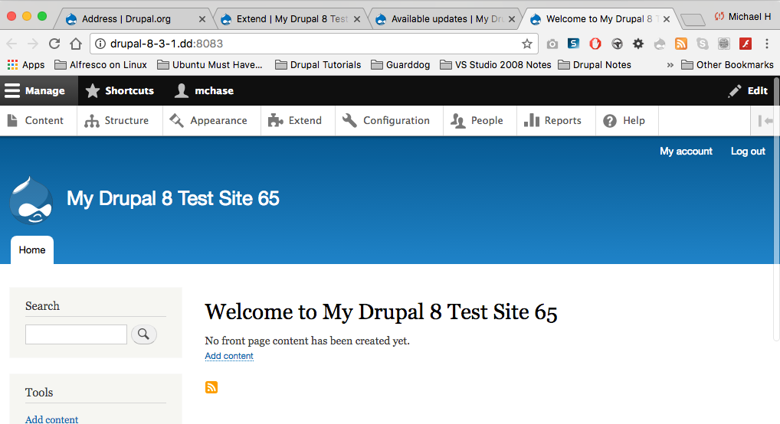
Before you continue, make sure you have Installed and Configured your Acquia Drupal 8 site

Slide 26
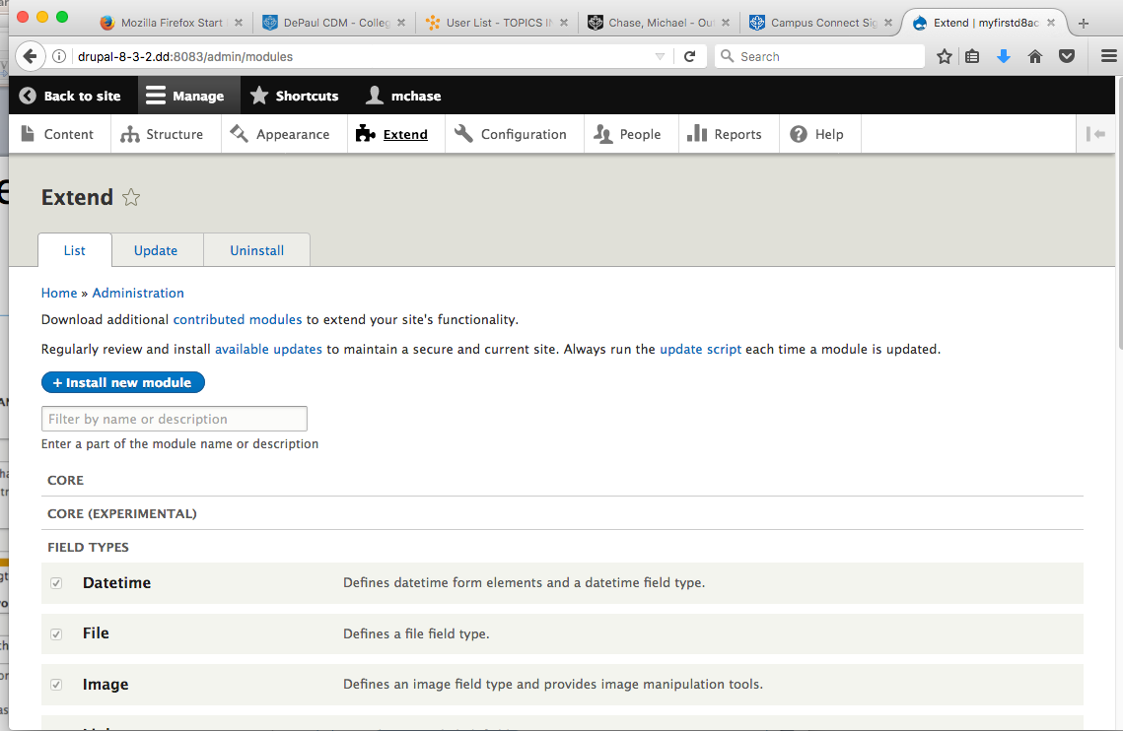
Drupal 8 Site Filed Types – Before Composer Address Module installation

Slide 27
Command Line Install Drupal 8 Address Module to an existing Drupal 8 CMS site on Acquia Dev Desktop
In the Terminal application run the 2 commands:
Add the Drupal.org Repository
composer config repositories.drupal composer https://packages.drupal.org/8
Download Address module
composer require “drupal/address ~1.0”

Slide 28
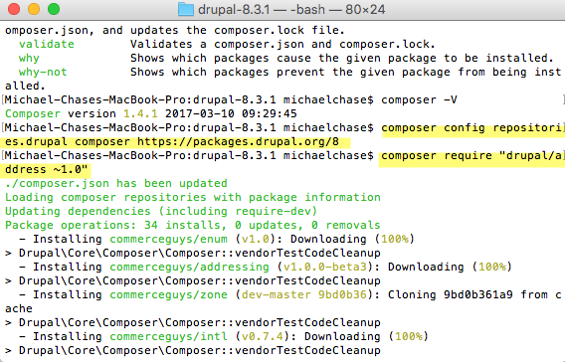
Composer commands to install the Address Module

Slide 29
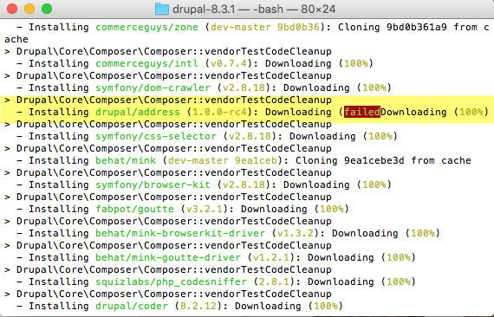
Composer commands – Address Failed Downloading?

Slide 30
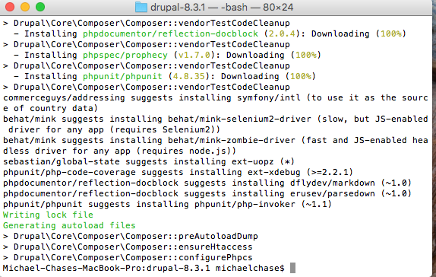
Composer commands completed

Slide 31
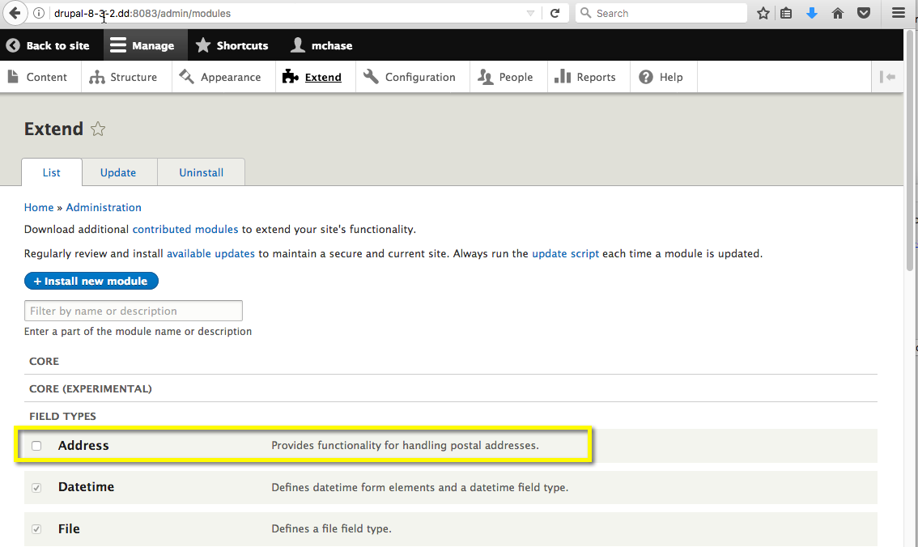
FIELD TYPES after Composer install of Address module

Slide 32
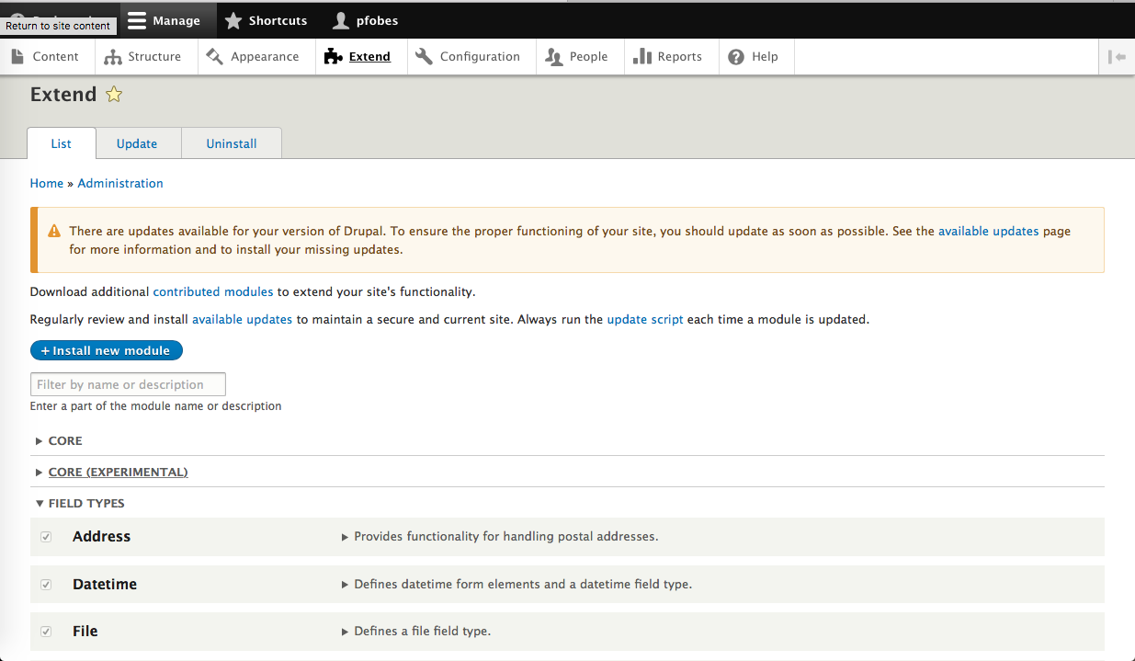
Address Module Enabled on Acquia Drupal site

Slide 33
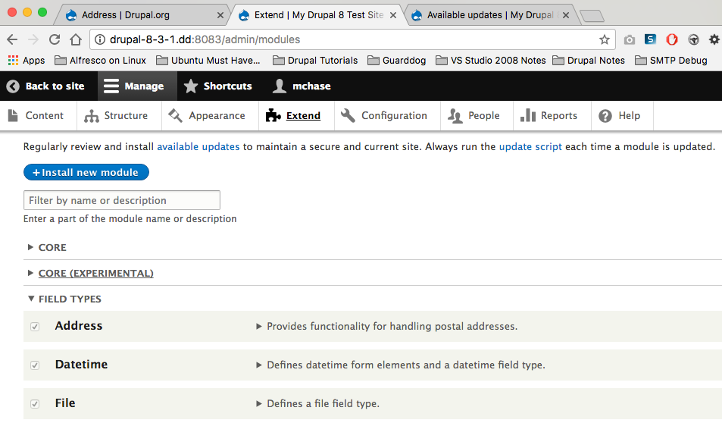
Address module successfully Installed and Enabled

Slide 34
References
Drupal 8 Address module: https://www.drupal.org/project/address
install composer: https://docs.acquia.com/resource/composer
Brew install: https://brew.sh
Brew commands:
https://gist.github.com/tomysmile/3b37ab4a1ddd604093fe724d0a882166

